Slide 1

Introduction to Event-Driven Architecture
Definition:Event-Driven Architecture (EDA) is a design paradigm where system components communicate by emitting and listening to events.
An event represents a significant change or action within the system (e.g., user actions, system-generated changes, external signals).
Why It Matters:Enables scalable, reactive, and flexible systems.
Widely used in real-time applications like financial trading, IoT, and gaming.

Slide 2
Key Concepts in EDA
Event:
A notification or message that something significant has occurred (e.g., a user making a purchase, a sensor reporting data).
Event Producer:
The component or service that generates the event. For example, an application that triggers an event when an order is placed.
Event Consumer:
The component that listens for and processes events. For example, a shipping service that reacts when an order is placed.
Event Channel:
A medium that delivers events from producers to consumers (e.g., message queues like Kafka, AWS SNS).

Slide 3
Benefits of Event-Driven Architecture
Loose Coupling:
Components are decoupled, reducing dependencies.
Changes in one component don't affect others as long as the event contract is respected.
Scalability:
Systems can scale efficiently by processing events asynchronously.
Ideal for high-traffic or high-volume environments.
Real-Time Processing:
Enables the immediate reaction to real-world events.
Crucial for real-time systems like fraud detection or monitoring applications.
Resilience:
Event-driven systems are often more fault-tolerant since consumers can process events when they are ready.

Slide 4
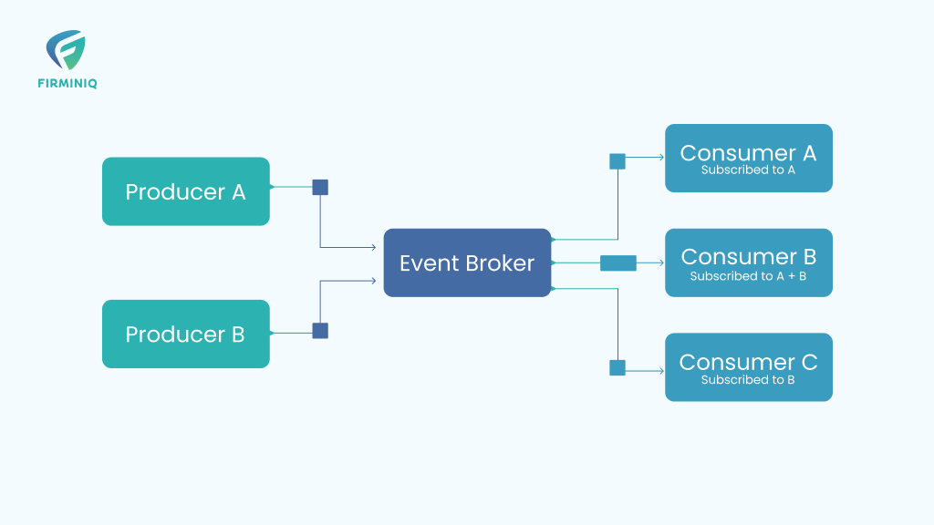
Architecture Flow
Example:
Producer: User places an order.
Event Channel: Event bus or queue (e.g., Kafka, RabbitMQ).
Consumer: Inventory management system processes the order.

Slide 5
Types of Event-Driven Architecture
Simple Event-Processing (SEP):
Event triggers an action in a consumer (simple one-to-one relationship).
Complex Event Processing (CEP):
Multiple events are processed together to infer higher-level outcomes (e.g., detecting fraud by analyzing patterns across multiple transactions).
Event Sourcing:
The system stores every change in the state as an event (append-only). Consumers can reconstruct state by replaying events.

Slide 6
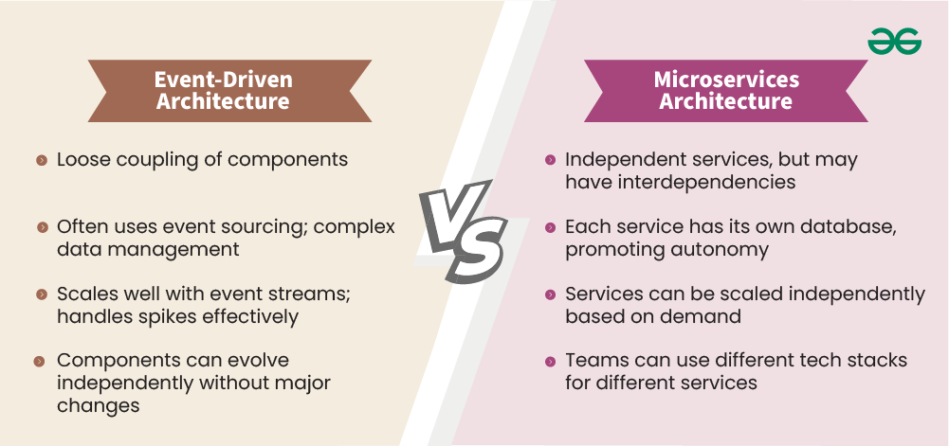
Event-Driven Systems vs Traditional Architectures
Traditional (Monolithic) Architecture:
Synchronous, tightly coupled components.
Harder to scale, modify, or add new functionality.
Event-Driven Architecture:
Asynchronous, loosely coupled components.
Easier to scale, adapt, and extend with minimal disruption.

Slide 7
Real-World Use Cases
E-commerce:
An order event triggers actions like payment processing, inventory management, and shipping updates.
IoT (Internet of Things):
Sensors trigger events (e.g., temperature change), and systems react accordingly (e.g., adjust HVAC, notify maintenance).
Financial Systems:
Real-time fraud detection through the continuous monitoring of financial transactions.
Gaming:
Event-driven systems can manage real-time player actions, in-game events, and server scaling.

Slide 8
Tools and Technologies
Message Brokers:
Kafka, RabbitMQ, Amazon SQS, NATS.
Event Streaming Platforms:
Apache Kafka, AWS Kinesis.
Serverless Computing:
AWS Lambda, Azure Functions (for event-driven serverless apps).
Event Processing Frameworks:
Apache Flink, Apache Storm.

Slide 9
Challenges in Event-Driven Architecture
Event Ordering:
Ensuring events are processed in the correct sequence when necessary.
Event Duplication:
Handling potential duplicate events due to retries or network issues.
Debugging & Monitoring:
Monitoring and troubleshooting distributed event systems can be complex.
Data Consistency:
Maintaining consistency between services in highly distributed systems.

Slide 10
Best Practices
Event Design:
Ensure events are lightweight, containing just the necessary information.
Event Contract:
Define clear contracts for the events (e.g., formats, semantics) to avoid integration issues.
Idempotency:
Consumers should be able to process events multiple times without adverse effects.
Event Versioning:
Plan for backward compatibility in event consumers and producers.

Slide 11
Future of Event-Driven Architecture
Event-Driven Microservices:
Growing popularity of using EDA to manage microservices communication.
AI & Machine Learning:
Real-time event processing combined with AI for decision-making (e.g., predictive analytics).
Edge Computing:
Increasing use of EDA for real-time event processing closer to the data source (e.g., IoT devices).

